Slide 1


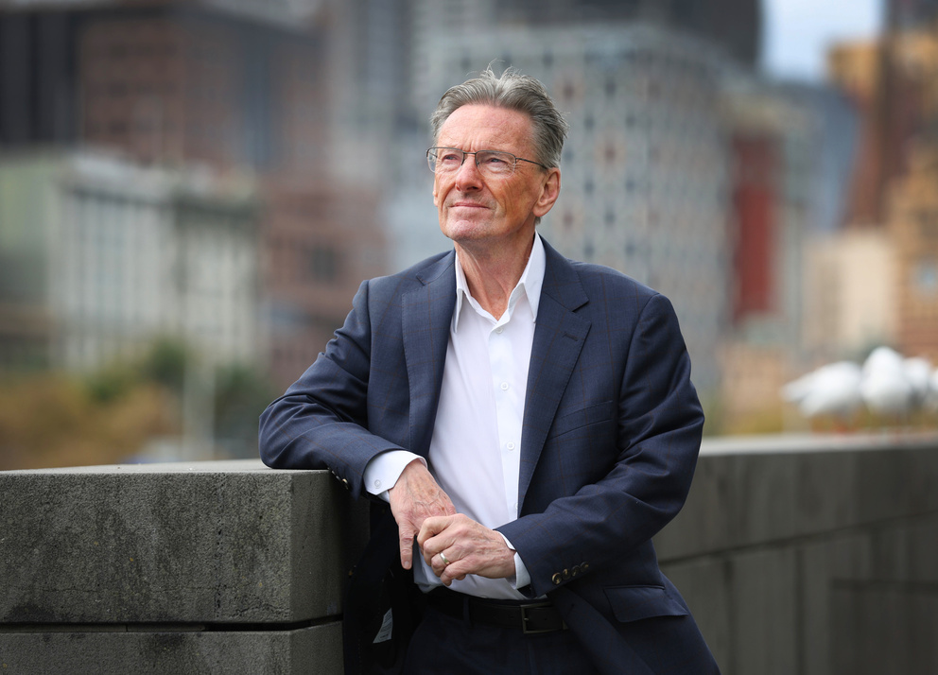
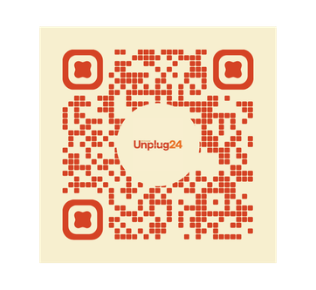
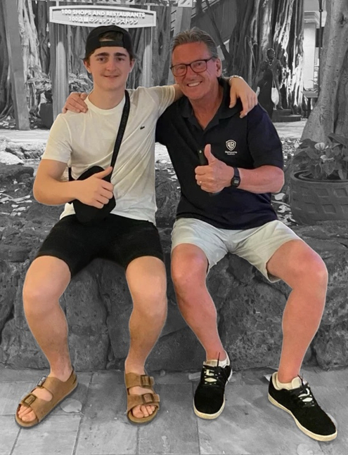
An Australian registered charity
SmackTalk
Online harms &
suicide prevention
smacktalk.org.au
Unplug from social media and reconnect with what matters
24 hours on October 24
Organisations can delete this box or add their own local Unplug24 event information here
Pledge for free now
#unplug24

